Slide 1

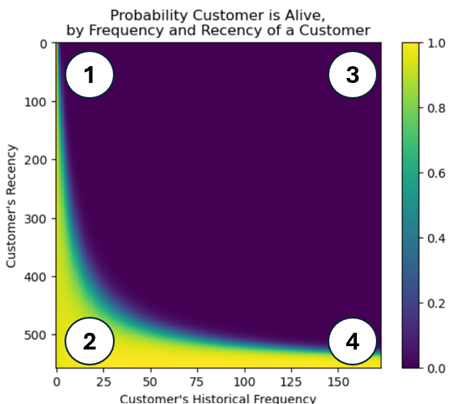
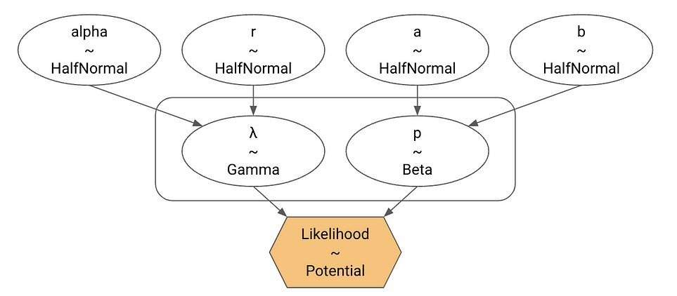
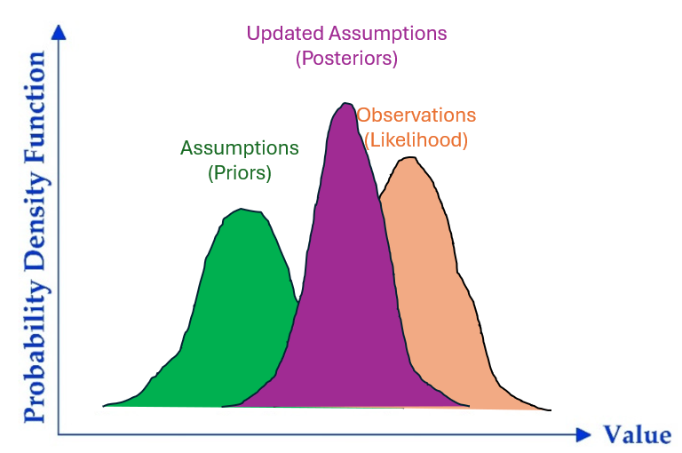



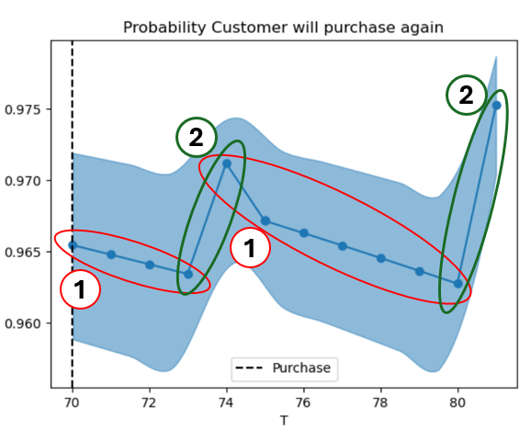
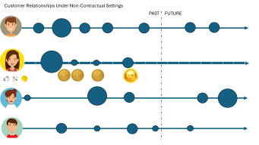
Customer Lifetime Value Buy Till You Die Modelling With PyMC Marketing
Z.

Slide 2
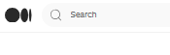
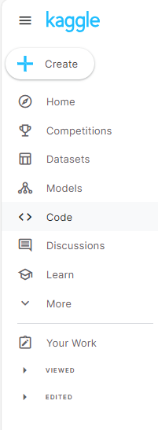
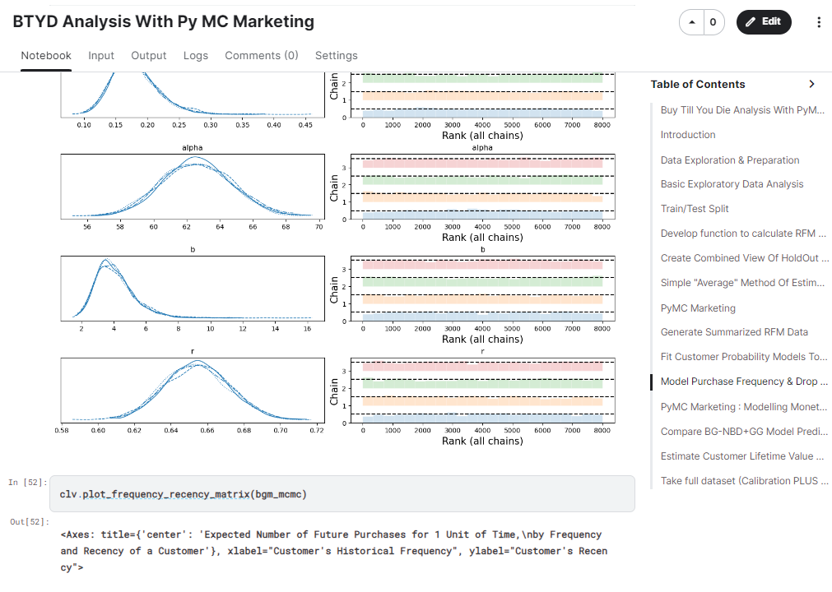
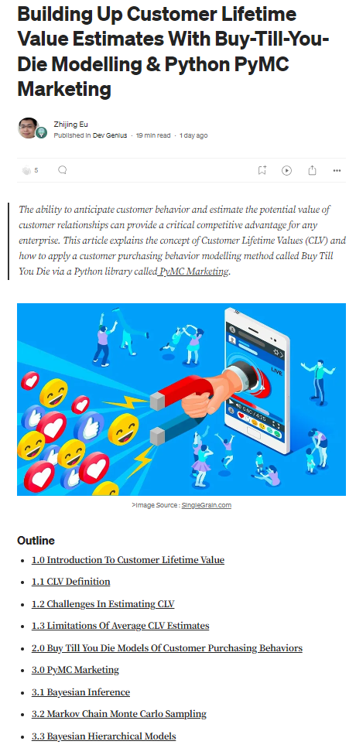
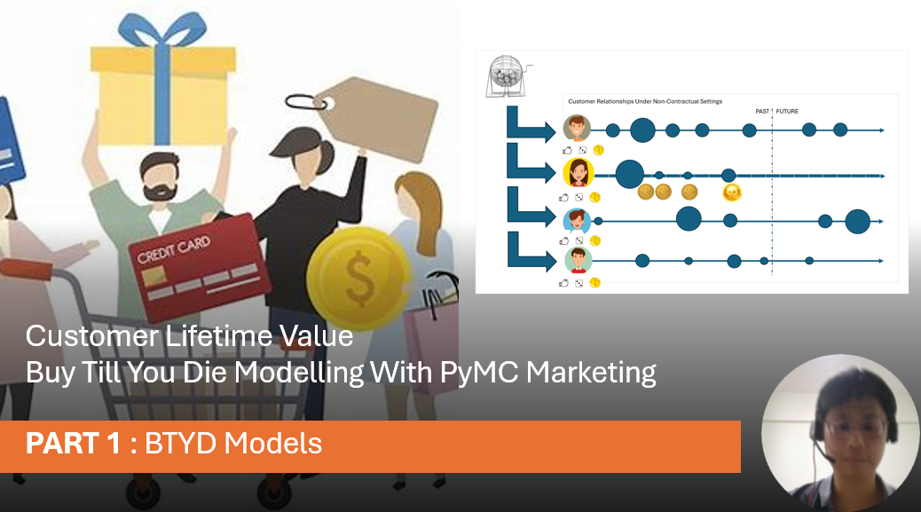
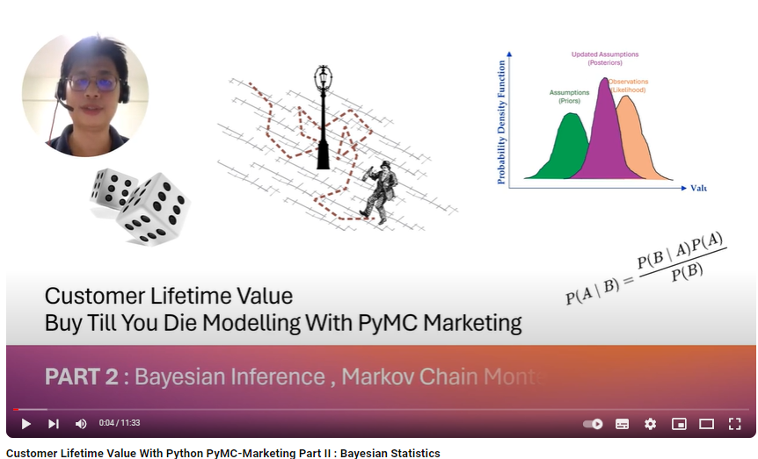

Slide 3

Customer Lifetime Value Buy Till You Die Modelling With PyMC Marketing PART 1 : BTYD Models
Z.

Slide 4

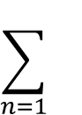
Customer Relationships With Regular Subscription Fee Based Contracts
Expected Customer Lifetime Value (CLV)=
Sum of Subscriptions Over Contract Lifetime
PAST
FUTURE
Contract
Period
$$\sum_{n=1}{}$$
$$$
$$$
$$$
$$$
$$$
$$$
$$$
Average CLV =
Ave $ Value/Transaction x
Ave Purchase Frequency x
Ave Customer “Lifespan”
Customer Lifetime Value is a useful concept because it helps determine:
Which customers are the highest value to the enterprise ?
How much effort/cost should be invested into ACQUIRING new customers ?
How much effort/cost needs to be invested to RETAINING existing customers ?

Slide 5
Customer Relationships Under Non-Contractual Settings
Expected Customer Lifetime Value (CLV) =
Sum of Expected Purchases Over Total Relationship Period
PAST
FUTURE
$$\sum_{n=1}{}$$
???
?
?
?
?
Challenges in forecasting CLV :
Will a customer make a purchase in the coming period ?
How much in $ value do we expect them to spend when they buy ?
Will they continue to buy the in future or have they “churned” away ?

Slide 6




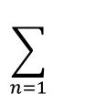
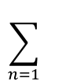
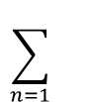
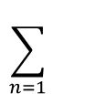
MULTIPLE Customer Relationships Under Non-Contractual Settings With Ad Hoc Buying Behaviours
Expected Customer Lifetime Value (CLV)
PAST
FUTURE
$$\sum_{n=1}{}$$
???
$$\sum_{n=1}{}$$
???
$$\sum_{n=1}{}$$
???
Challenges in forecasting :
Will a customer will buy in the coming period ?
How much do we expect them to spend when they buy ?
Will they still buy in the future, or have they churned away ?
How to account for differences in behaviours BETWEEN customers ?
$$\sum_{n=1}{}$$
???

Slide 7


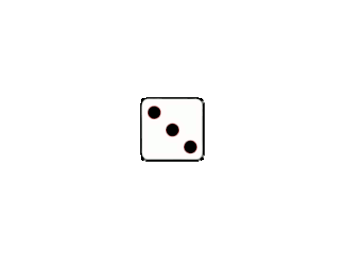
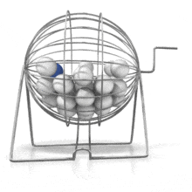
Buy Till You Die Modelling
Probabilistically models customer buying behavior as a series of statistical distributions
Predicts behavior using transaction records and individual customer Age, Recency , Frequency & Monetary Value
Deals with variability at two levels :
Individual customer level – models frequency of buying and whether customer is active (i.e alive/dead) AND monetary value of each purchase
Population level – models variability BETWEEN different customers where the parameters for Individual Customers follow another probability distribution
Has a few “flavours” but most common are:
Beta Geometric Distribution / Negative Binomial BG/NBD for drop-out rate (alive/dead) and frequency
Gamma-Gamma GG for monetary value
Image Source : Alamy

Slide 8


Customer Relationships Under Non-Contractual Settings With Ad Hoc Buying Behaviours
PAST
FUTURE

Slide 9
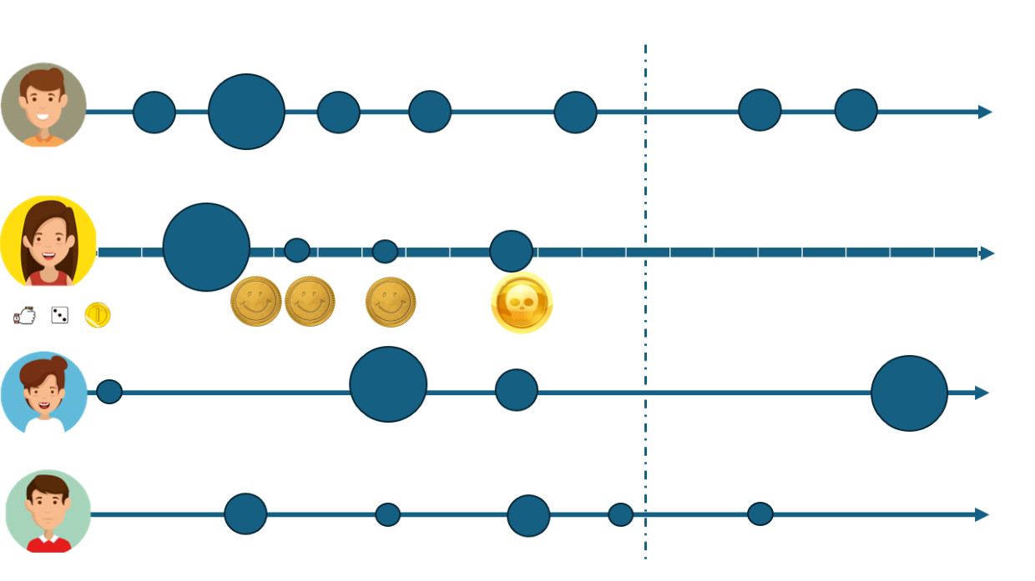


Slide 10
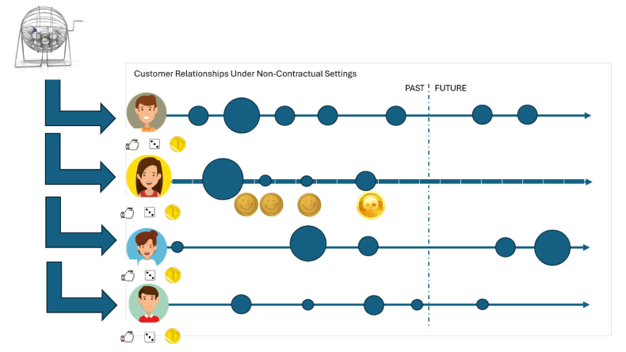
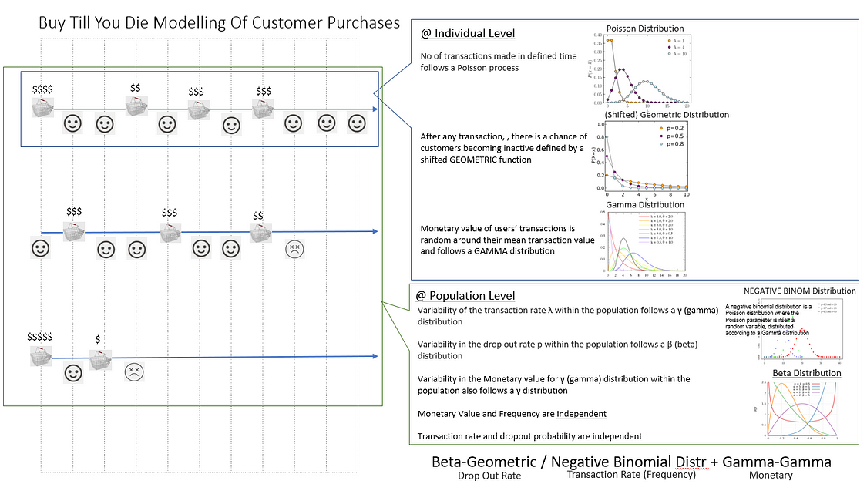
Beta-Geometric / Negative Binomial (BG-NBD) + Gamma-Gamma (GG)
➔
Customer Lifetime Value (CLV)
Drop Out Rate
(alive/dead)
Transaction Rate
(frequency)
Monetary Value
($$$)

Slide 11
Customer Relationships Under Non-Contractual Settings
PAST
FUTURE

Slide 12
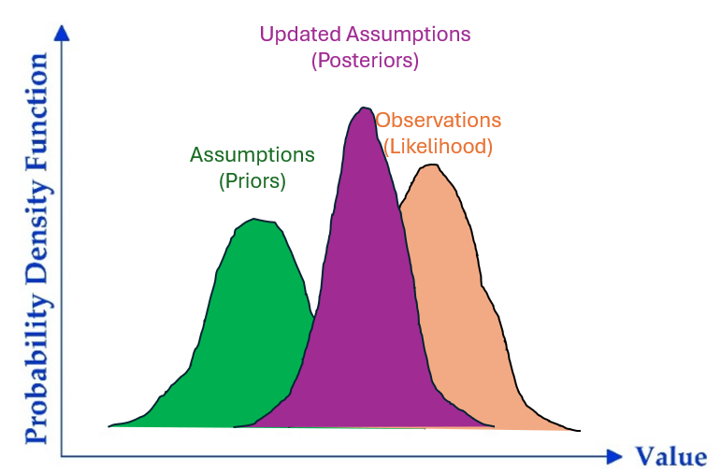
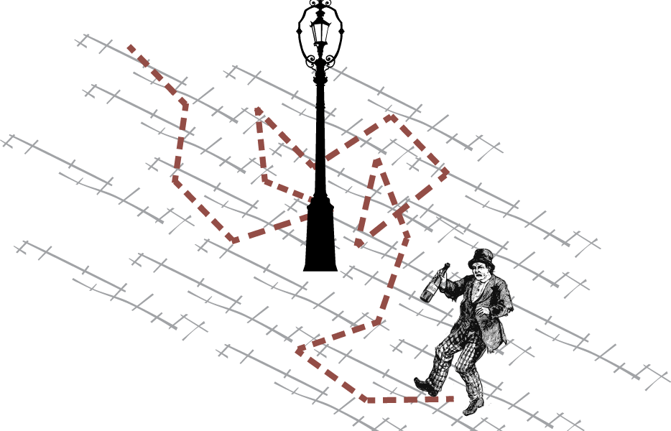

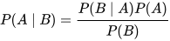
Customer Lifetime Value Buy Till You Die Modelling With PyMC Marketing PART 2 : Bayesian Inference & Hierarchical Modelling and Markov Chain Monte Carlo Sampling
Z.

Slide 13
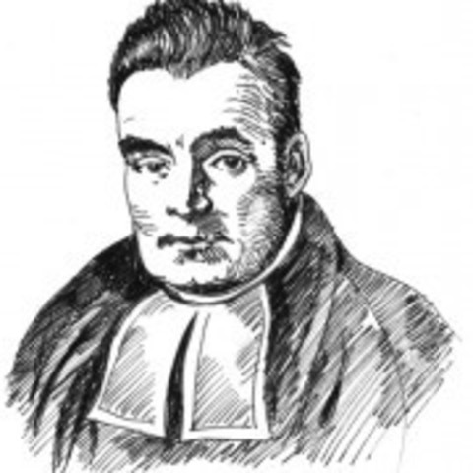
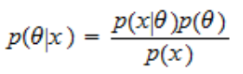
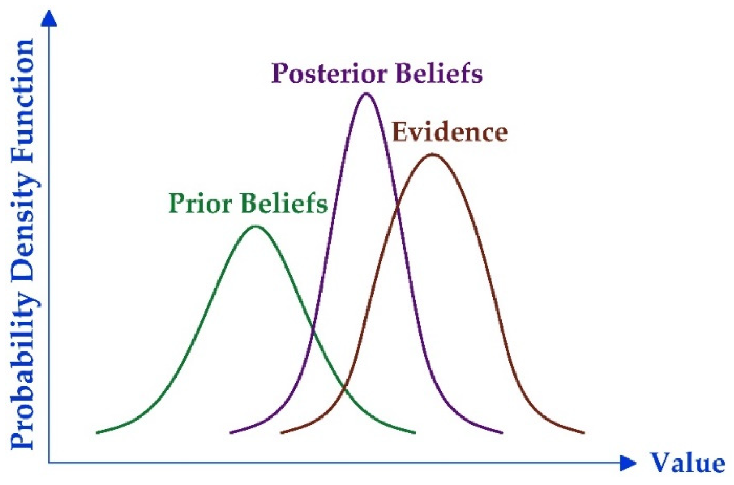
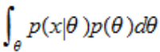
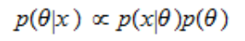
Bayesian Inference
In “traditional” ML, outputs are derived from a single estimates of each attribute (e.g. Regression Coefficients)
Bayesian Inference relies assigning subjective probabilities to assumed distributions (prior) and updating beliefs (posterior) based on observed data (likelihood)
Likelihood
Prior
Posterior
Updated Assumptions
(Posteriors)
Posterior
Likelihood
Prior
Underlying
(Unknown) Distribution
Marginal distribution form of p(x)
Observations
(Likelihood)
Assumptions
(Priors)
The marginal density DOES NOT depend on the theta because it is integrated out
Therefore, the equation simplifies to the posterior being proportional to the Likelihood and Prior
From the observed data and prior, a posterior probability can be estimated that represents an improved understanding based on evidence
Notes:
The marginal distribution of a subset of a collection of random variables is the probability distribution of the variables contained in the subset.
It gives the probabilities of various values of the variables in the subset without reference to the values of the other variables.

Slide 14
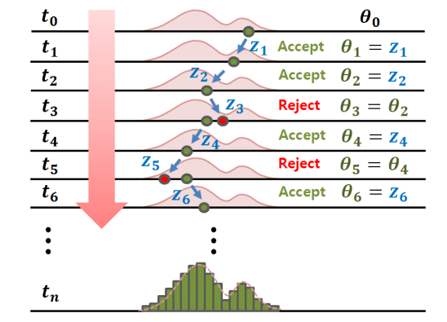
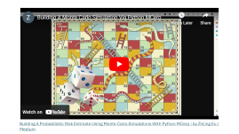
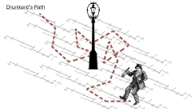
Markov Chain Monte Carlo Sampling
Markov Chains are a sequence of possible events in which the probability of each event depends only on the state attained in the previous event
The Monte Carlo method uses random variables as inputs , runs repeat simulations to analyze total results & the inputs with the most influence
MCMC essentially combines the two methods to generate sequences of dependent observations by:
Breaking down probabilities into smaller / simpler components
Sampling from these simpler components via simulation
Estimating underlying probability distributions by comparing & selecting parameters that best explain the observed data
In PyMC Marketing , multiple chains of Monte Carlo simulations are generated where the results (e.g. parameters of the BG/NBD or GG statistical distributions) are reflected as a range
Image Source : Adaptive Markov chain Monte Carlo algorithms for Bayesian inference (2019) Jin, Seung-Seop & Ju, Heekun & Jung, Hyung-Jo.
Notes:
We can imagine an MCMC algorithm as a black box that takes two inputs:
an initial value ;
a target distribution.
The output is a sequence of values .
Although the first values of the sequence are extracted from distributions that can be quite different from the target distribution, the similarity between these distributions and the target progressively increases: when is large, is drawn from a distribution that is very similar to the target.

Slide 15
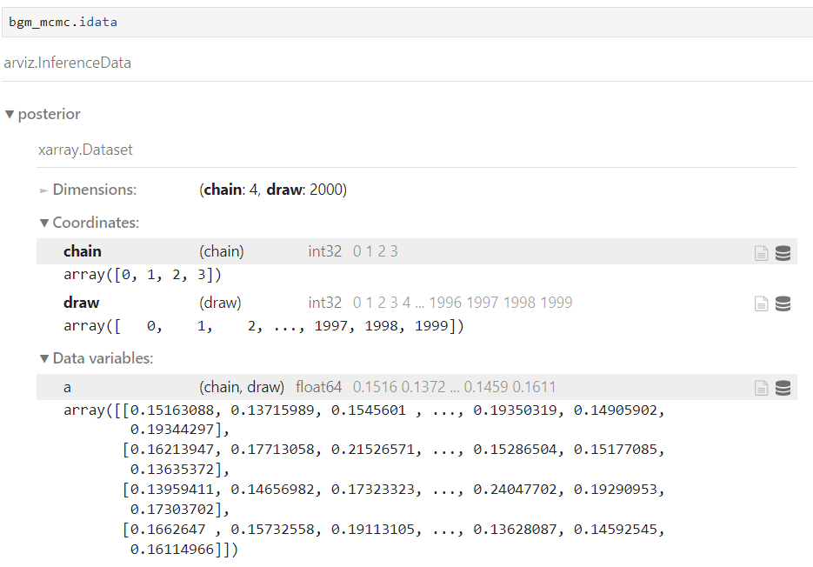
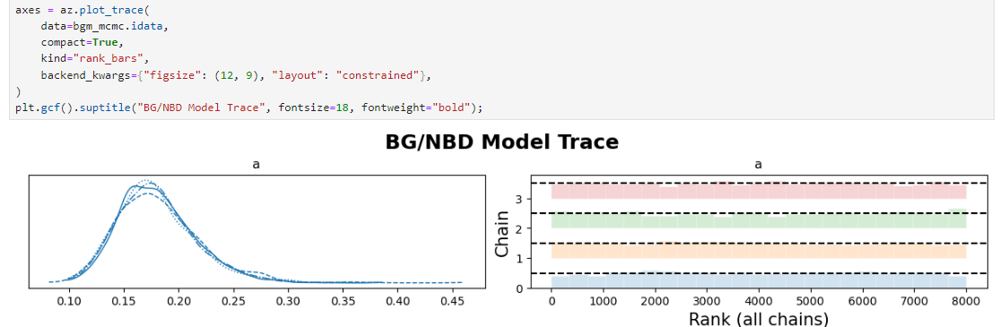
Markov Chain Monte Carlo Sampling
Py MC uses another Python Library called Arviz which has functions for posterior analysis, data storage, sample diagnostics, model checking, and comparison.
Every time a model is fitted, it converts the MCMC results into an Inference Data Object

Slide 16
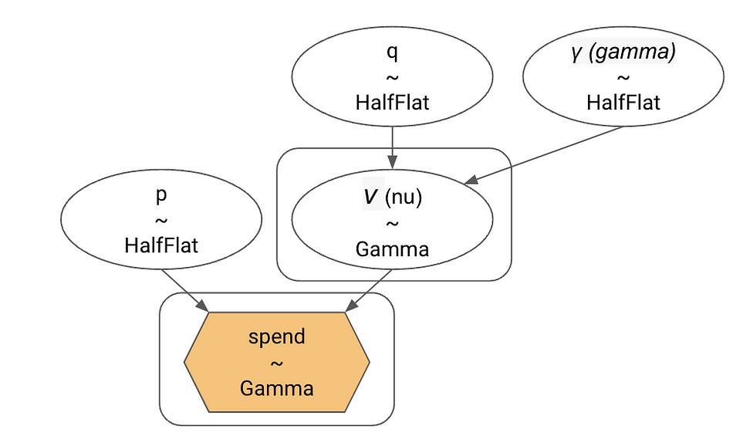
Bayesian Hierarchical Models
PyMC Marketing is an open-source Python library that leverages Bayesian /Probabilistic Programming methods to answer data-driven questions.
Bayesian Hierarchical Models take advantage of Bayesian statistics to reflect “layers” (i.e hierarchies) of probabilities within a model
Beta-Geometric / Negative Binomial (BG-NBD)
Gamma-Gamma (GG)
Image Source : Customer Lifetime Value Prediction with PyMC-Marketing (2023) by Hajime Takeda

Slide 17
Drunkard’s Path

Slide 18
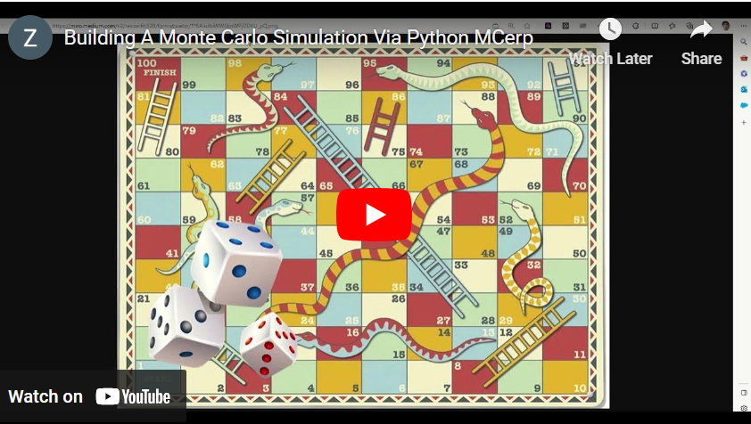
Building A Probabilistic Risk Estimate Using Monte Carlo Simulations With Python MCerp | by Zhijing Eu | Medium

Slide 19


Customer Lifetime Value Buy Till You Die Modelling With PyMC Marketing PART 3 : Python Code Along
Z.

Slide 20


Code Walk-Thru

Slide 21

Data Loading & Cleaning

Slide 22
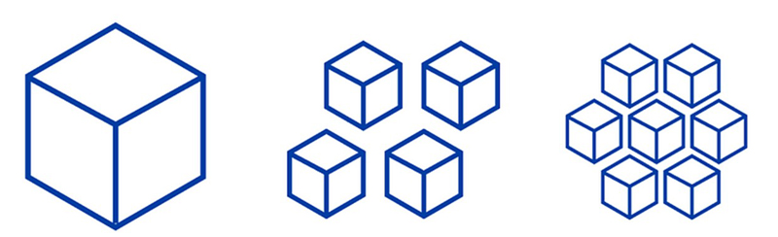




Choosing The Right Time Granularity

Slide 23

Exploratory Data Analysis

Slide 24
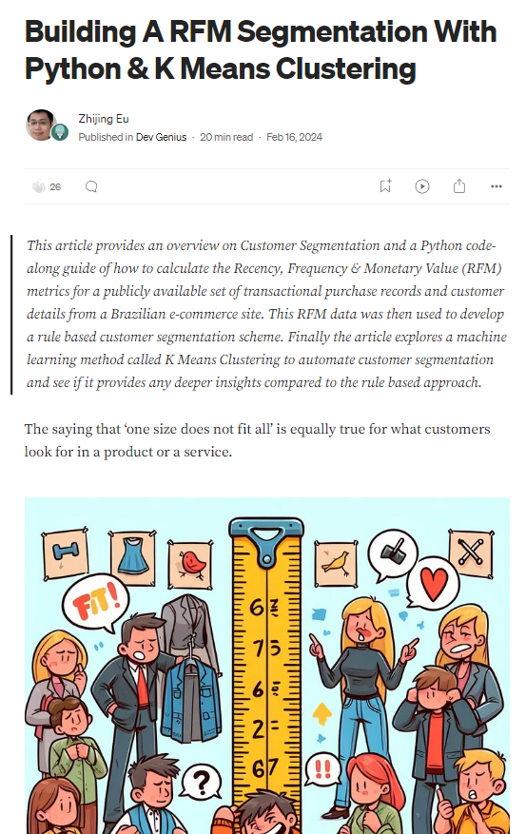
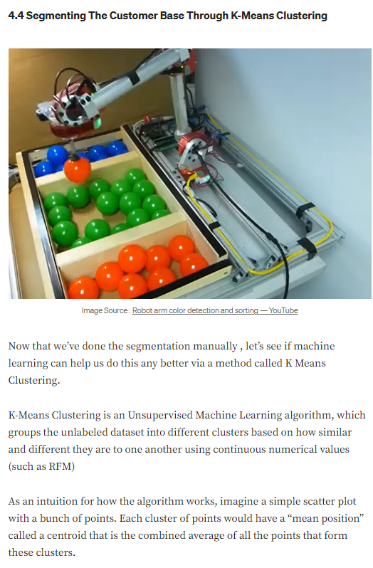
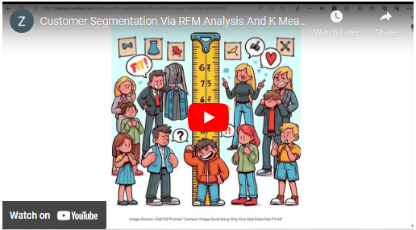
RFM (Redux)

Slide 25
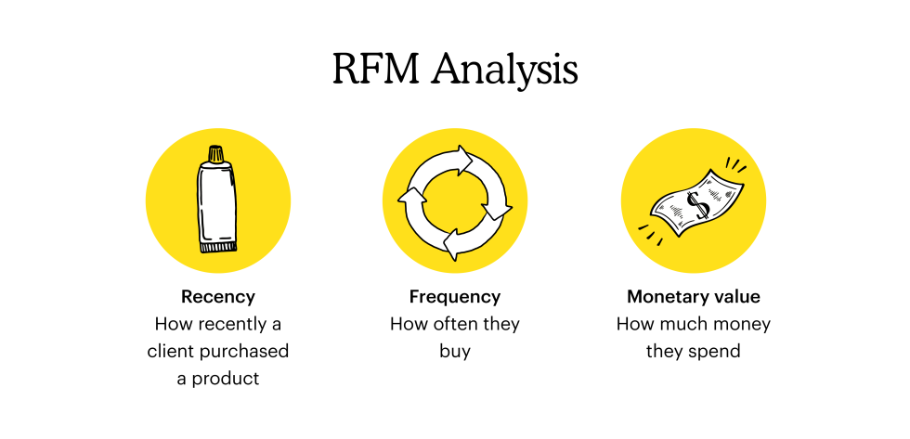
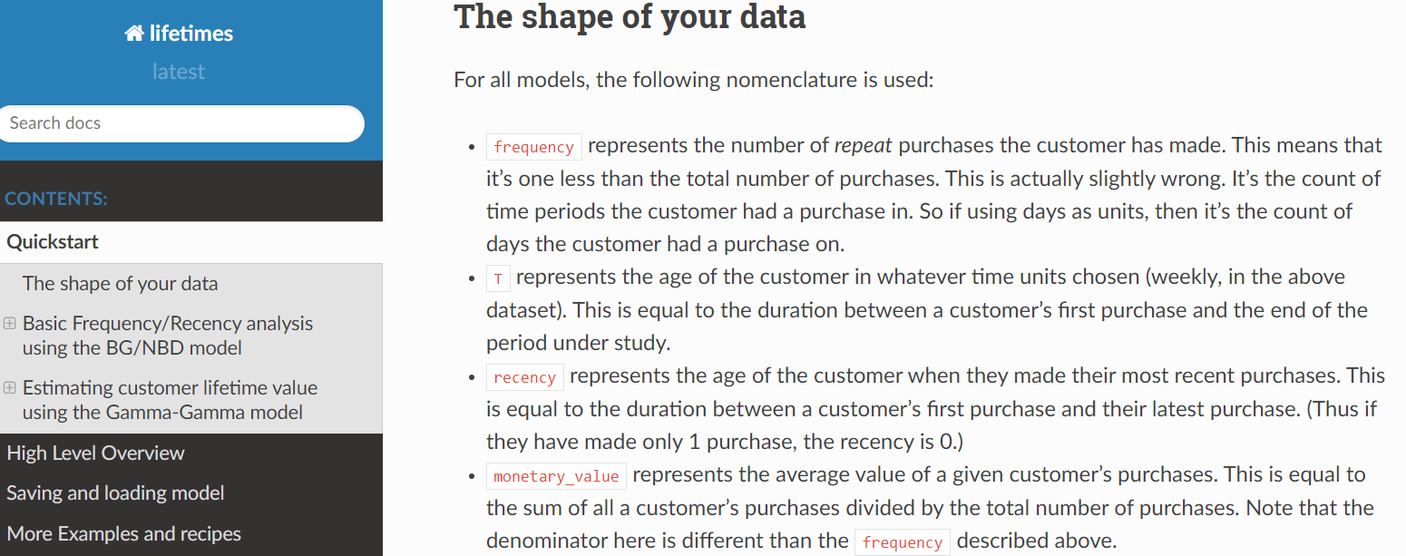
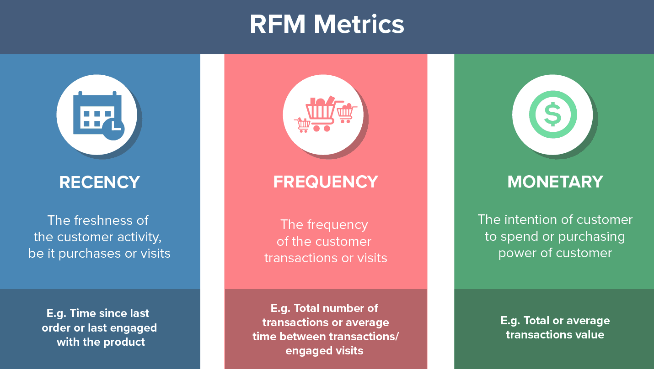
RFM : Sharper Definitions For BTYD Modelling

Slide 26
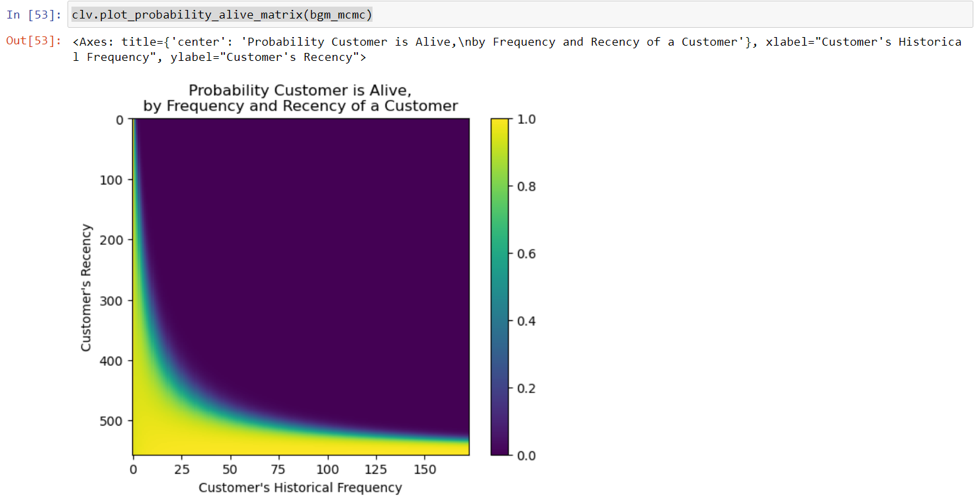
1
Inactive “Tried It Out & Left” Customers – Low Frequency customers who may have bought a bit in the past but have not transacted recently (Low Recency)
New Customers - High Recency (i.e just started buying) with Low Frequency customers
At Risk of Leaving “Premium” Customers - High Frequency (have bought a lot in the past) but Low Recency (not bought anything recently)
Loyal Repeat Customers – Bought many times in the past (High Frequency) AND also High Recency – i.e bought recently)
1
3
2
3
4
2
4

Slide 27
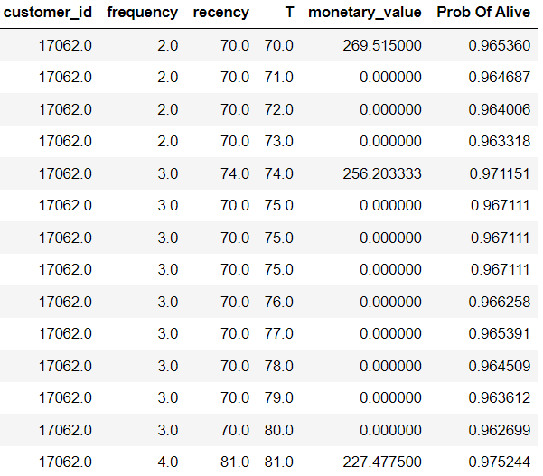
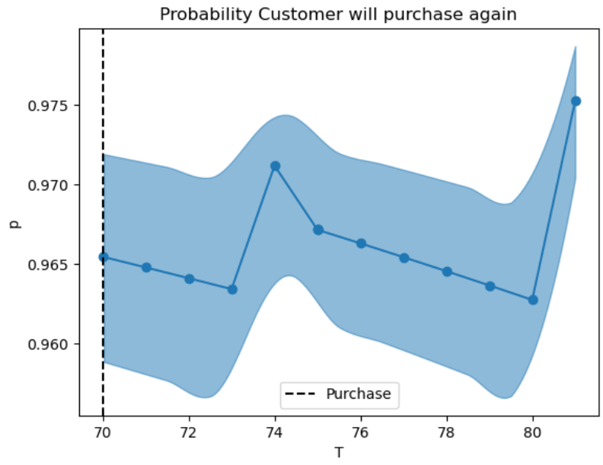
2
2
1
1
1
In the Beta Geometric model of drop-out rate (Alive/Dead), the % of probability the customer still being active drops the longer no purchase are made
2
However, this % of probability of being active gains a boost immediately after a new purchase

